Slide 1

POS SYSTEM
JS-FRONT

Slide 2

OBJECTIVE FOR TODAY
Project duration
What we expect you to do?
Project Evaluation Grid
Roles
Project & Feature

Slide 3


Before start, let’s have some fun!!
THE SHOPING GAME
5 groups of 15 students
In group divide 2 roles:
5 Sellers
10 Buyers
PNC’s Mart B31
You can take 3 balls
3
7
Check out is here!
Buyers
1
5
Sellers
You cannot buy same color

Slide 4



START
MON DEC 11th
END
WED DEC 20TH Midnight
PRESENTATION
THU DEC 21ST
DESIGN
CODE
END
JURY

Slide 5
WHAT WE EXPECT
Choose the features to code, and decide in which order you will code them.
Code your POS SYSTEM site
Present your site

Slide 6

WHAT YOU CANNOT DO:
Copy paste from friends
we will check the similarities between code
Code from internet if you don’t understand it
you may be asked to explain your code

Slide 7

HOW WILL WE EVALUATE ?
YOUR
PROJECT
PROJECT
SATISFY
YOUR
PRESENTATION
65%
05%
30%

Slide 8




Team organisation during Project
Each member is a developer
Each member is also assigned to a role
TASK MANAGER
QA TESTER
GIT MANAGER

Slide 9
Who is task manager?
TASK MANAGER
The task manager is responsible for:
Following up on the tasks assigned to all team members, ensuring they have assigned responsibilities throughout the day.
Leading the stand-up meeting every morning, including:
Inquiring about what each team member accomplished yesterday.
Asking about their planned tasks for today.
Inquiring if there are any problems or challenges they are facing.
Reporting the team's progress to the tutor every day.

Slide 10
Who is GIT manager?
GIT MANAGER
The Git manager is responsible for:
Creating a repository on GitHub.
GitHub Board to manage tasks progression.
Adding team members to the repository.
Controlling merge requests from team members.
Solving conflict if it happened.
Communicating with the QA manager to conduct testing after merging the new feature.

Slide 11
Who is QA tester manager?
QA TESTER
The QA tester is responsible for:
Preparing the TEST PLAN DOCUMENT for all team members using Google Spreadsheet.
Requesting all team members to write a test plan for their feature while in development.
After the Git manager merges the code, conducting MANUAL TESTS according to the test plan for each feature.
Updating the status (PASS or FAILED) based on the test results.
Noted: All team members must write the test plan and perform the initial test on their own machines before merging.

Slide 12

TASK ESTIMATION
How long do you think it will take to do each ticket?
Estimating Tasks will be important in your job!
Understand the task
Break down the task into subtasks
e.g. Divide ‘ratings’:
Create local storage for rating
Make button to add rating
Make onClick() function
Calculate new rating
Show rating
Estimate each subtask
Add estimates together
If you estimate all the tickets before choosing,
it will help you find which ones will get you
the easiest points!

Slide 13

TEST PLANNING
Planning tests is a great way to check understanding of the requirements before you write code!
How can you be sure your code works?
Make a TEST PLAN in Excel, Word, Notepad or other
Test Name | Description | Expected output | Test Date | Pass / Fail?
Add to Cart, simple case | Click ‘Add to Cart’, check using Console if data has been added | Item should be in ‘cart’ array, with correct details | 1/12 | PASS
Add to Cart, repeat | Click ‘Add to Cart’ twice, check using Console if data has been added | There should be two items in ‘cart’ array | 1/12 | PASS
Add to Cart local storage | Add item to cart. Press ‘refresh’. Check Console. | Item should still be in ‘cart’ array | 1/12 | FAIL
…etc | …etc | …etc

Slide 14
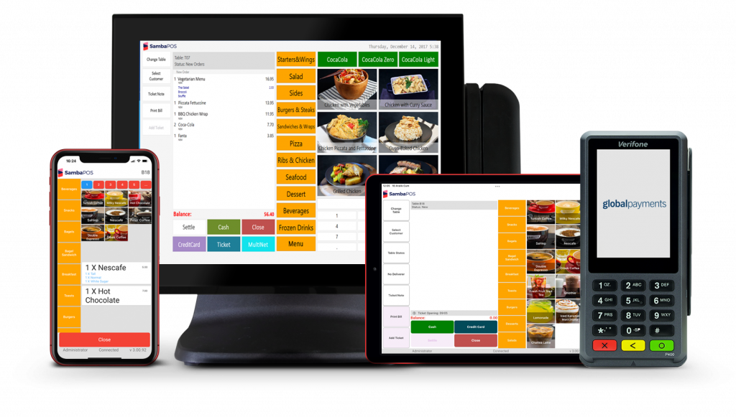
WHAT
IS
POS SYSTEM

Slide 15
FEATURES
DESCRIPTIONS

Slide 16






Mandatory Features
Add new product
Display products
Remove product
Bonus
Menu
Clean Code
10 Points
05 Points
05 Points
05 Points
10 Points
Layout
Add new Category
Display Categories
Remove Categories
05 Points
10 Points
05 Points
05 Points

Slide 17





Basic Features
Update product
Search
Display product detail
Add Product to Cart
10 Points
05 Points
15 Points
10 Points
Update Category
Filter By Categories
Input validation
Calculate Price in Cart
10 Points
10 Points
15 Points
15 Points

Slide 18




Advance Features
Sell progress of each products
Create Invoice
(Sold out history)
Show best selling products
Display low-stock products.
20 Points
15 Points
15 Points
15 Points
Income Cost
15 Points

Slide 19
YOUR FEATURES

Slide 20
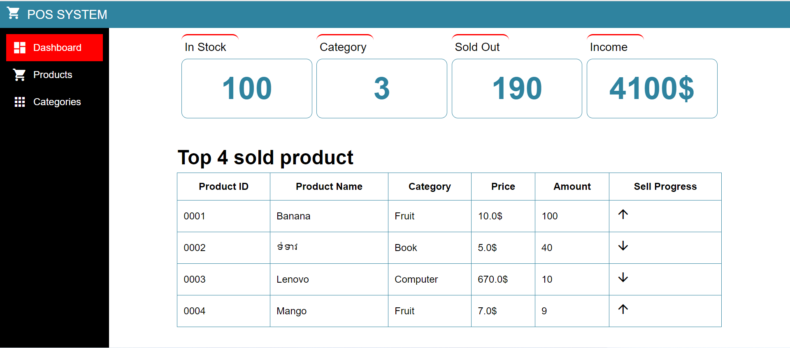
F1: SITE-WIDE / MANDATORY MENU BAR

Slide 21
F2: SITE-WIDE / MANDATORY
CLEAN CODE
Features divided sensibly between files?
Spelling in variable, functions and filenames? Consistent naming?
Do the variable and function names help the judges understand what the code is doing?
Useful commenting?
Avoid bad coding practices in the recommended code guidelines?
Variables declared and used only in the scope they’re needed?
e.g. unnecessary global variables, loop variables declared before the loop for no reason, etc
Constant variables defined as const?
Spacing, indentation etc?
End javascript lines with semicolons?
JS will work without semicolons, but it makes it safer against bugs.
Notes:
The judges will be reading lots of code to assess these projects - so, if you make your code easy to understand, you will make the judges happy!

Slide 22
F3: SITE-WIDE / OPTION
Name:
VALIDATE INPUT
Ensure that the name is not empty.
Set a maximum character limit to avoid excessively long names.
Check that input fields are valid inputs
Do this for all pages with inputs!
Category:
Ensure that the name is not empty.
Ensure that a category is selected.
Name:
Net and Gross Price:
Ensure that the name is not empty.
Ensure that the price is a valid numerical value.
Check if the price is within a reasonable range (e.g., not negative)
Category:
Net Price:
Quantity:
Ensure that the name is not empty.
Ensure that the price is a valid numerical value.
Check if the price is within a reasonable range (e.g., not negative)
Gross Price:
Quantity:
Description:
Set a maximum character limit for the description.
Description:

Slide 23
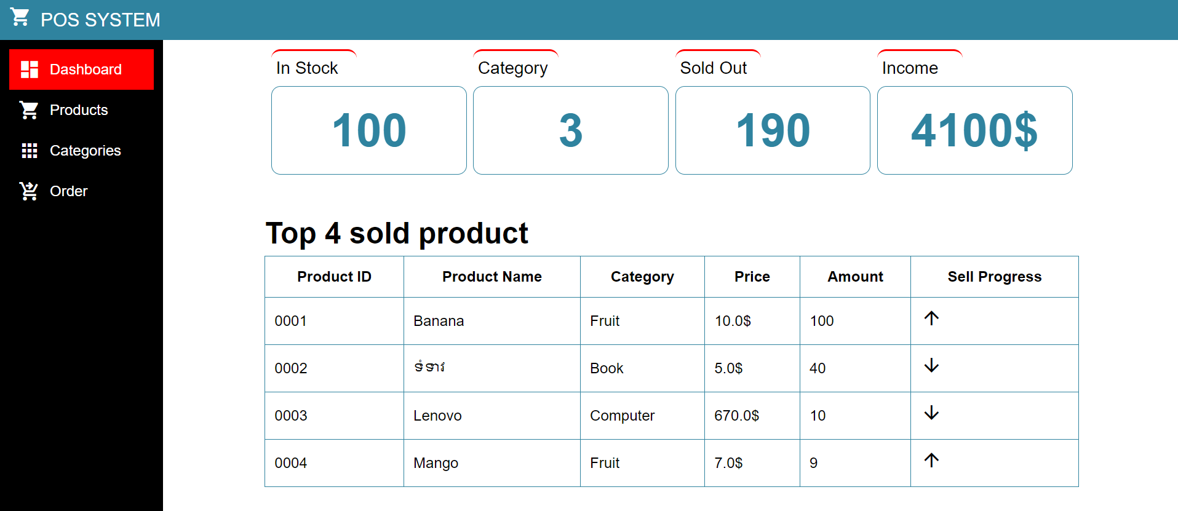
F4: SITE-WIDE / OPTION NICE LAYOUT
CSS styling - alignment - font choice - good colour scheme -
correct English - nice images - easy to use - etc

Slide 24
F5: PRODUCT/ MANDATORY
CREATE PRODUCT
Form to add a product in the list of products
Store results in Local Storage
Name:
Category:
Net Price:
Gross Price:
Quantity:
Description:
SAVE

Slide 25
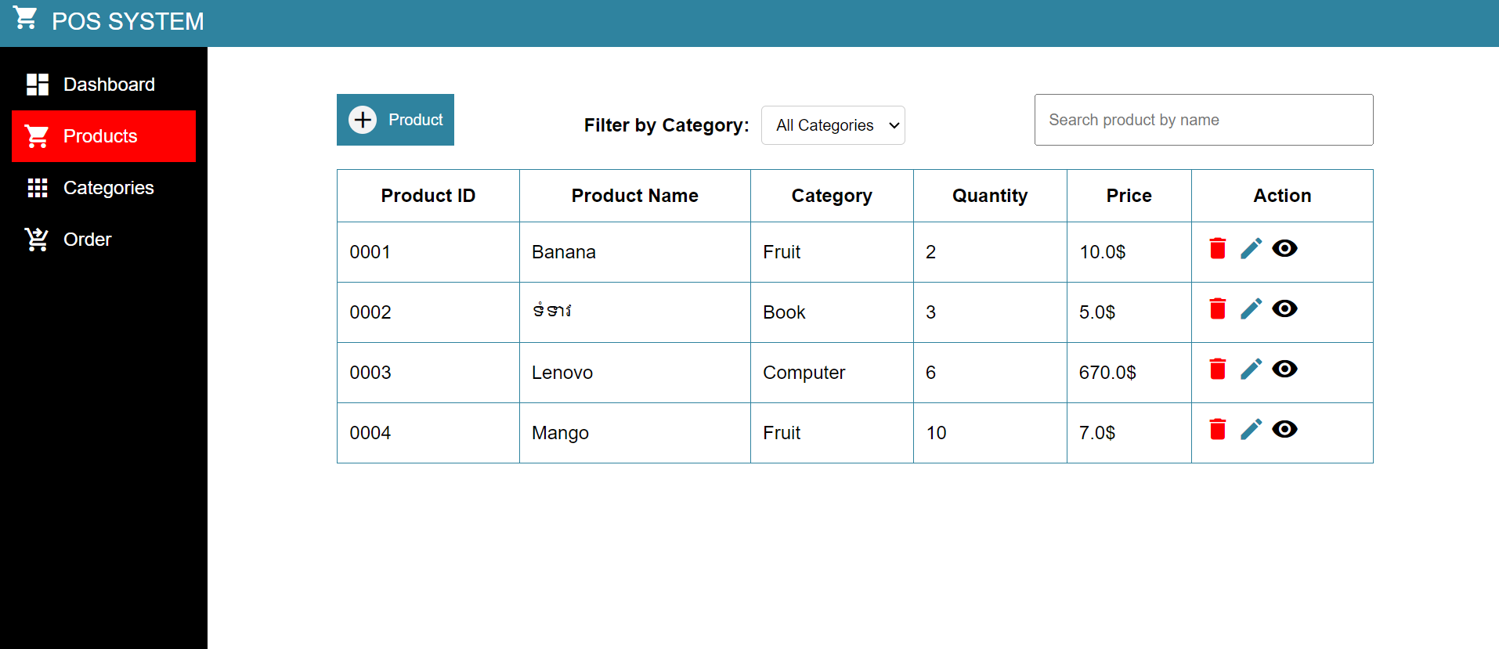
F6: PRODUCT/ MANDATORY
List the products in a grid
Show only buttons for seller, e.g.
Edit product
Delete product
Detail product
Check product
DISPLAY PRODUCTS

Slide 26
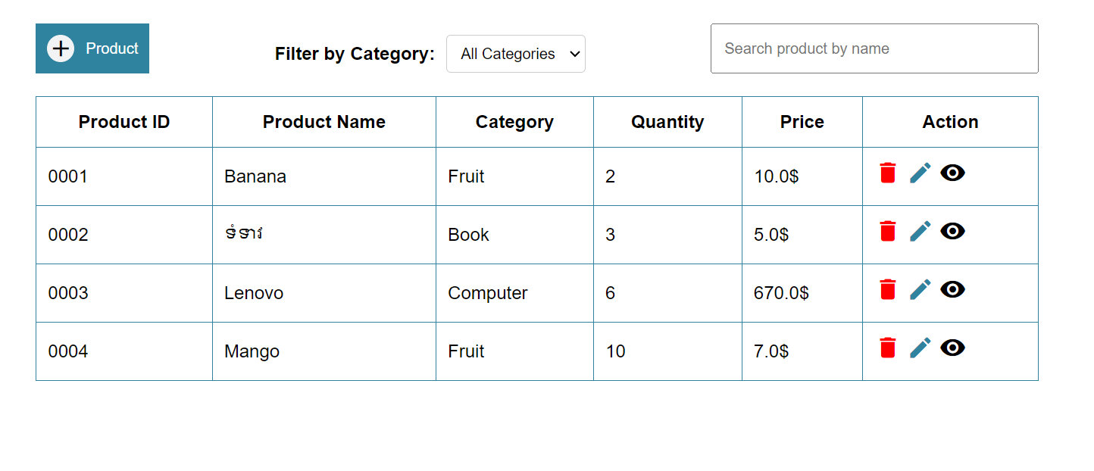
F7: PRODUCT/ MANDATORY
REMOVE A PRODUCT
Delete a product
Should have confirm delete

Slide 27
F8: PRODUCT / OPTION UPDATE PRODUCT
Form to update a product chosen from the list of products
Name:
Old name
Category:
Old category
Net Price:
Old price
Old price
How does the seller choose which product to update?
Gross Price:
Quantity:
Old quantity
Description:
Old description
UPDATE
Notes:
Ca c’est la feature de recherche plutôt Le filtre serait un filtre sur les propriétés

Slide 28
F9: CATEGORY/ MANDATORY
CREATE CATEGORY
Store results in Local Storage
Name:
Description:
SAVE

Slide 29
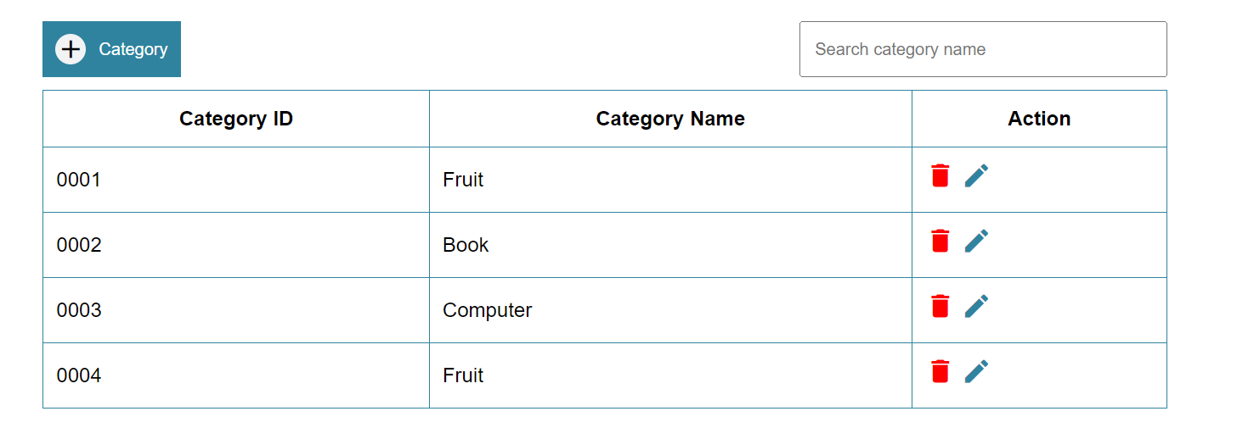
F10: CATEGORY/ MANDATORY
List the category in a grid
Show only buttons for seller, e.g.
Edit product
Delete product
DISPLAY CATEGORY

Slide 30
F11: PRODUCT/ MANDATORY
REMOVE A CATEGORY
Delete a category
should have confirm delete

Slide 31
F12: PRODUCT / OPTION UPDATE CATEGORY
Form to update a category chosen from the list of categories
Name:
Old name
Description:
Old description
How does the seller choose which category to update?
UPDATE
Notes:
Ca c’est la feature de recherche plutôt Le filtre serait un filtre sur les propriétés

Slide 32
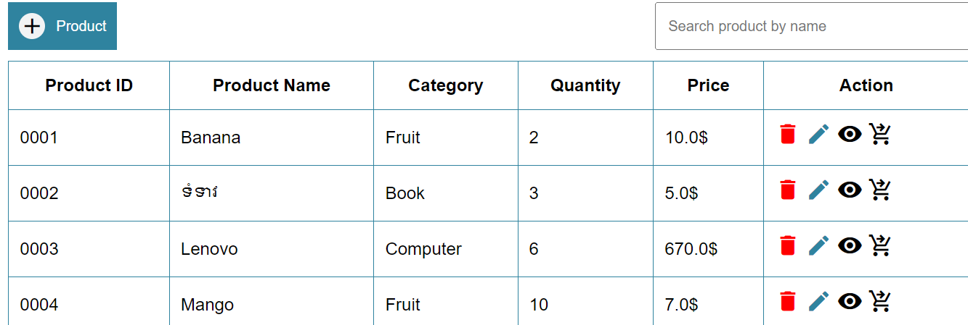
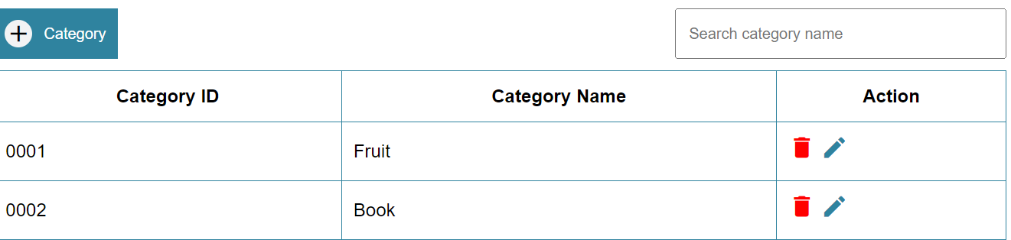
F13: ADD UP/ OPTION SEARCH
When you search the product OR category will listing base on your search.
Search product
Search category
Notes:
Ca c’est la feature de recherche plutôt Le filtre serait un filtre sur les propriétés

Slide 33
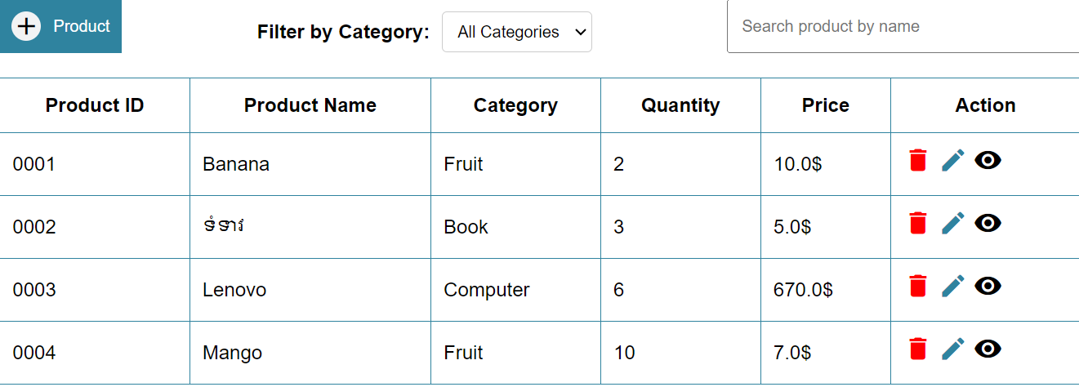
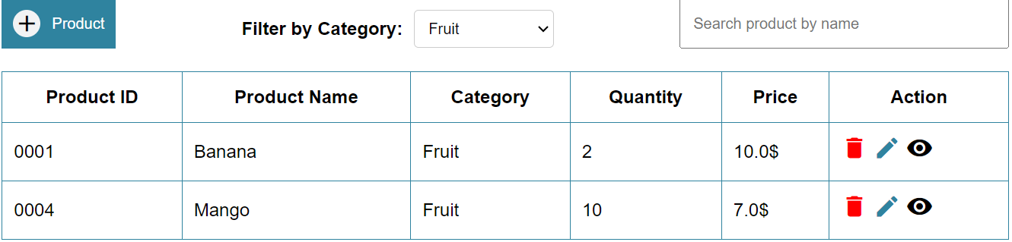
F14: ADD UP/ OPTION FILTER CATEGORY
The product will listing page group by category
filter by category
Notes:
Ca c’est la feature de recherche plutôt Le filtre serait un filtre sur les propriétés

Slide 34
F15: ADD UP/ OPTION DISPLAY DETAIL PRODUCT
Name : Banana
1. Please click this icon
Category : Fruit
Quantity : 5
Quantity in stock : 2
Net price : 0.75$
Gross price : 1$
Sold out : 01-12-2023 10:59
: 2 (amount)
2. After we click detail icon will show detail pro.
: 2 $ (price)
Sold out : 01-12-2023 11:10
: 1 (amount)
: 1 $ (price)
Total price-amount sold out 3$ - 3
Notes:
Ca c’est la feature de recherche plutôt Le filtre serait un filtre sur les propriétés

Slide 35

F16: ADD UP/ OPTION LIST THE MOST WAS SOLD
Display the product was sold base on amount.
Notes:
Ca c’est la feature de recherche plutôt Le filtre serait un filtre sur les propriétés

Slide 36
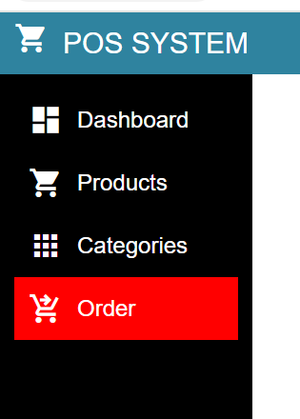

F17: ADD UP/ OPTION CHECK OUT PRODUCT
1. Please click this Order menu
0001
LIST CARTS
0001
BANANA
2
3$
0002
COCONUT
5
10$
BANANA
0003
LENOVO
1
150.50$
QTY:2
3$
0004
MANGO
3
21$
ADD TO CART
PROCESSING
TOTAL:184.50$
1 you need to search pro by ID
2 you need to add pro to cart
CHECK OUT
3 you can choose quantity of pro
4 you can remove pro from carts
5 final you can check out
Notes:
Ca c’est la feature de recherche plutôt Le filtre serait un filtre sur les propriétés

Slide 37

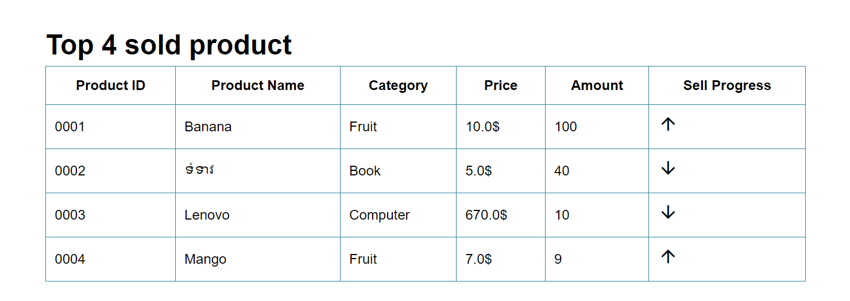
F18: ADD UP/ OPTION SELL PRESSING PRODUCT
1. During 1 hour was sold
2. During 1 hour wasn’t sold
Notes:
Ca c’est la feature de recherche plutôt Le filtre serait un filtre sur les propriétés

Slide 38
F19: ADD UP/ OPTION INCOMING COST
1. Show the incoming cost of all product that company profit
Notes:
Ca c’est la feature de recherche plutôt Le filtre serait un filtre sur les propriétés

Slide 39
F20: ADD UP/ OPTION SHOW PRODUCT INSTOCK / SOLD OUT AND CATEGORY
1. Show total in stock product
2. Show total sold out product
3. Show total category
Notes:
Ca c’est la feature de recherche plutôt Le filtre serait un filtre sur les propriétés

